Slide 1




WELCOME TO TREKOGO
Born in the Mountains
DC
by Dhyani Chauhan
PM
Priyanshi Maheriya
PG
Priyal Gadhiya
M
Advisor
Honey Patel
TREKOGO

Slide 2

INTRODUCTION TO TREKOGO
Project Background
Problem Statement
Our Solution
Importance of the Project
Trekogo is a travel website that simplifies trip planning. It was created from a love of travel and a need for easier planning.
Travelers face scattered information and generic suggestions. Personalization is missing in many platforms, making unique experiences hard to find.
Trekogo offers personalized recommendations and easy itinerary building. It uses smart algorithms to tailor trips to your unique tastes.
Our platform makes travel confident and simple. It creates memorable journeys by focusing on personal interests, saving time and effort.
TREKOGO

Slide 3
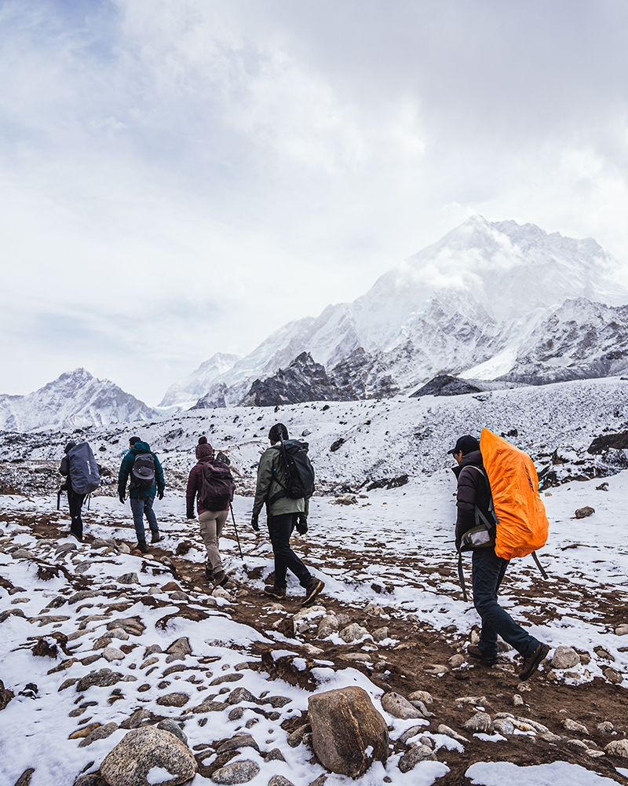
Project Objectives
User-friendly Platform
Trekogo is designed for effortless navigation, ensuring a smooth and enjoyable
experience from the moment you arrive.
Find destinations, activities, and travel tips with ease.
Personalized Recommendations
Trekogo learns your travel style and preferences to suggest experiences tailored
just for you.Discover hidden gems and unique adventures you'll love.
Streamlined Booking
Say goodbye to travel planning headaches!
Trekogo simplifies booking flights, accommodations, and activities,
all in one place Get the best deals and confirm your trip with confidence.
Community Engagement
Connect with fellow travelers, share your experiences, and get inspired!
Trekogo fosters a vibrant community where you can exchange tips,
discover new destinations, and build lasting friendships.
TREKOGO

Slide 4

Technology Stack
1
Frontend
Html and css for interactive user experience
2
Backend
Node.js with Express.js for robust API development
3
Database
MongoDB for flexible and scalable data storage
4
Cloud Hosting
AWS & Google Cloud for reliability and scalability
TREKOGO

Slide 5




Step-by-Step Process
Planning and Requirements Gathering
Defined the website’s purpose : A trekking focused platform
Frontend Development
HTML and CSS
Backend Development
Node js & Express
Database Integration
MongoDB
TREKOGO

Slide 6
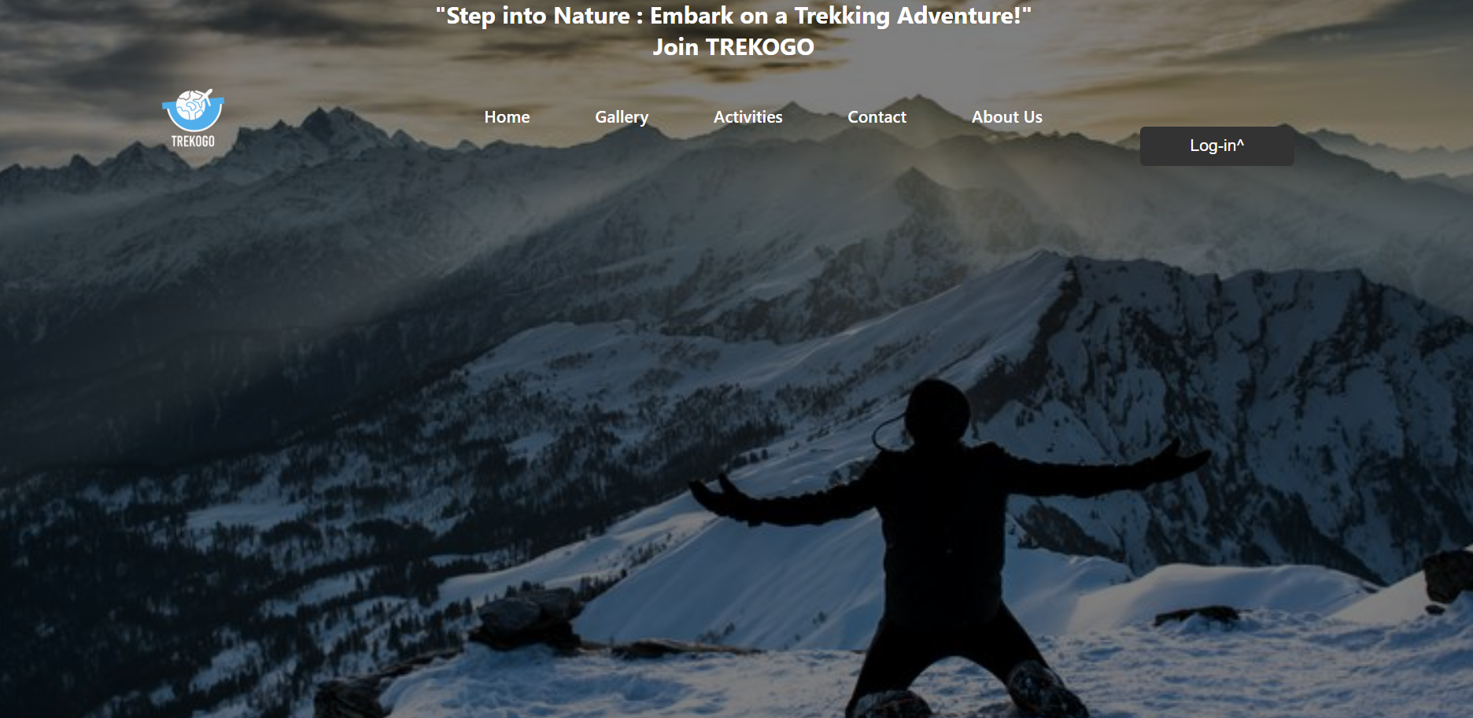
Implementation
Home page
TREKOGO

Slide 7
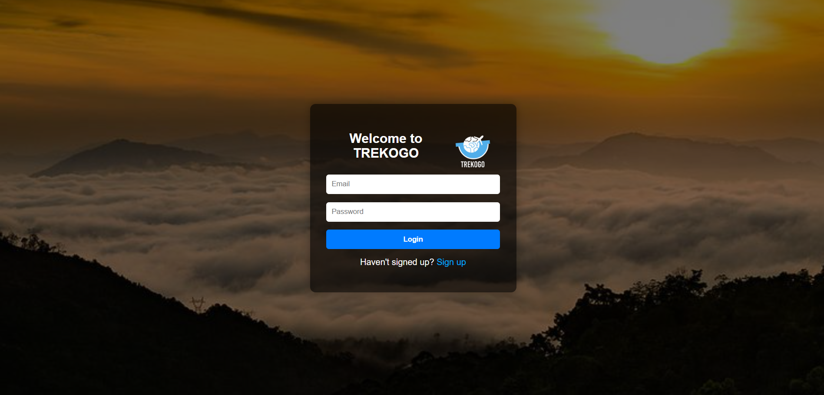
Login Page
TREKOGO

Slide 8
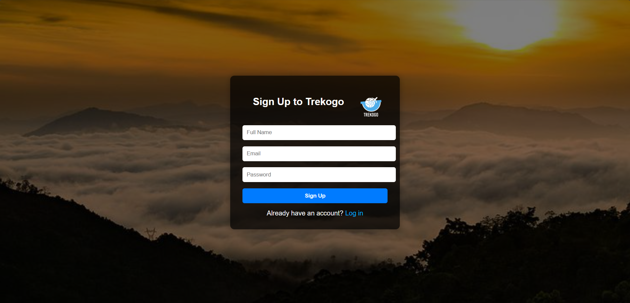
Sign up page
TREKOGO

Slide 9

Destination performence
Chandratala Lake: 30% increase in bookings, 20% higher engagement
Kedarkantha: Steady growth, 25% booking rise
Leh-Ladakh: Top destination, 45% bookings, high return visitors
Nandi Hills: High traffic, low bookings, marketing opportunity
Valley of Flowers: 15% increase in interest, 7% bookings
Key Results
1
2
3
40% overall traffic growth last quarter
Mobile bookings up 60%, needs mobile optimization
Users want more detailed travel guides
TREKOGO

Slide 10
Travel Trafic Chart
TREKOGO

Slide 11

Future Scope
Expansion: Integrate AI-powered route planning
and personalized fitness tracking for optimized
trekkingexperiences.
Partnerships: Collaborate with local guides and
sustainable tourism initiatives
to promote responsible travel.
Technology: Develop a mobile app with offline
maps, safety alerts,
and augmented reality features
for enhanced navigation.
Community: Expand the community forum
with user-generated content, expert
Q&A sessions, and virtual trekking events.
Personalization: Implement advanced
machine learning algorithms to
refine travel recommendations based on
user behavior and preferences.
TREKOGO

Slide 12
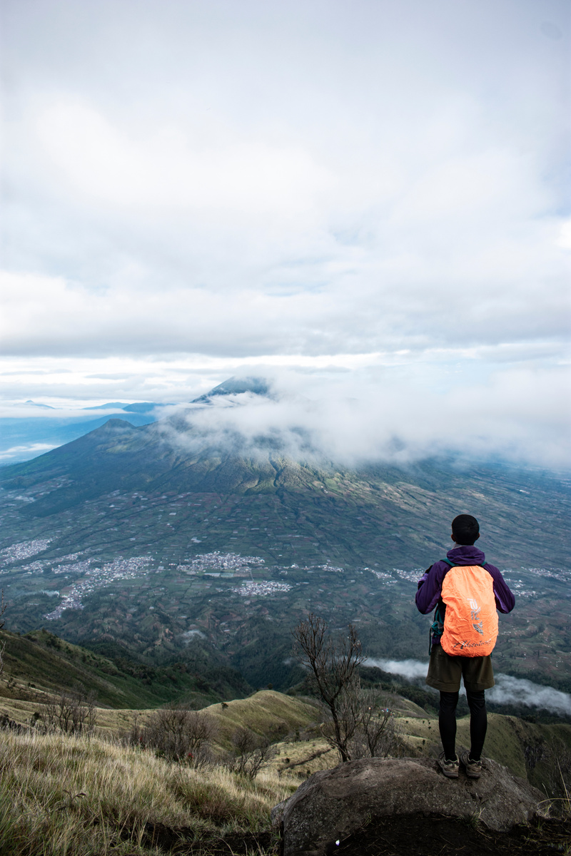
Conclusion & Refrences
Summary :
References :
Trekogo is a comprehensive travel website designed to connect users with unique trekking experiences. Key features include personalized recommendations, detailed trail information, secure booking options, and a vibrant community forum.
google & invicinble ngo
TREKOGO

Slide 13
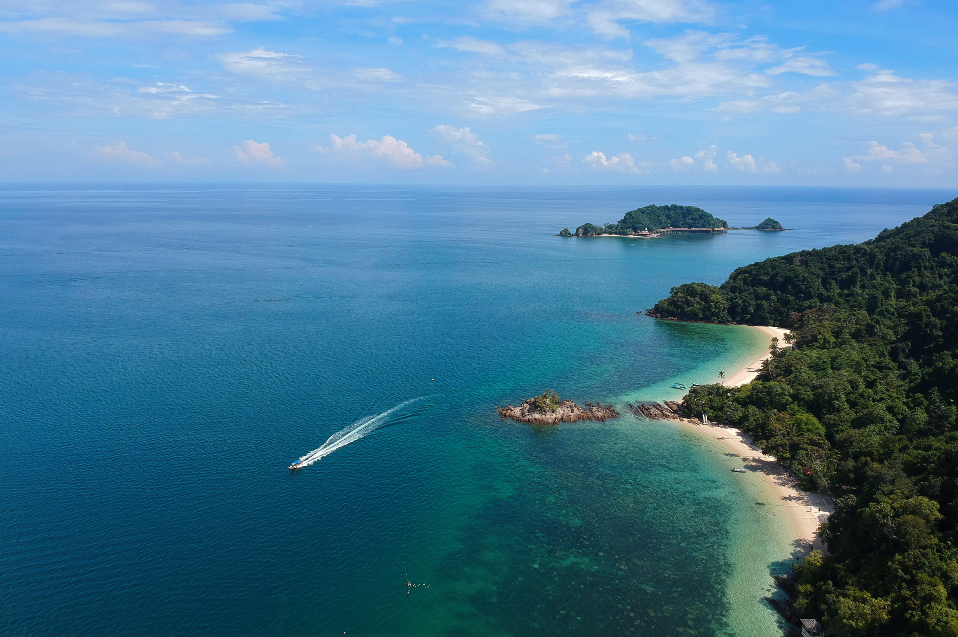
Thank
You!
Contact us:
+123-456-7890
www.trekogo.com
TREKOGO

